Slide 1


Introduction to Employee Salary Analysis
Analyzing employee salaries is crucial for understanding compensation trends, identifying potential inequities, and ensuring organizational competitiveness. This presentation will guide you through a comprehensive salary analysis using Excel, covering data gathering, cleaning, statistical calculations, and visual data representation.
SR
by Sasirekha Ramu

Slide 2

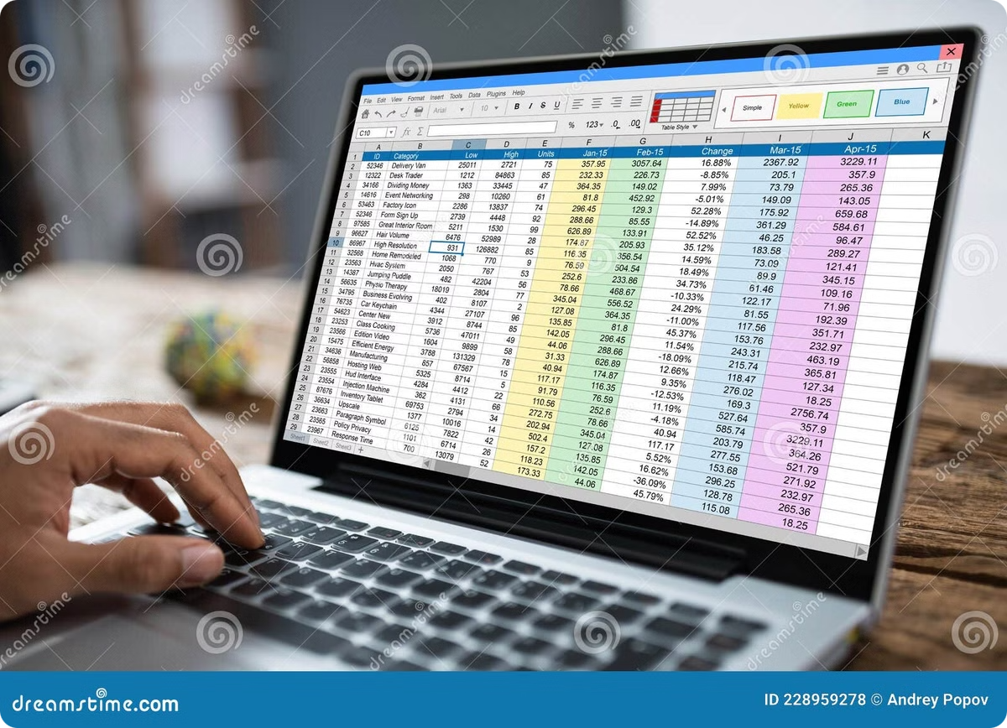
Gathering Salary Data in Excel
1
Collect Data
Gather employee salary information from your HR and payroll systems, ensuring you have details like job title, department, and years of experience.
2
Import to Excel
Import the salary data into a new Excel workbook, organizing it into a clear and structured format.
3
Review for Accuracy
Carefully review the data to identify any missing values, inconsistencies, or potential errors that may impact your analysis.

Slide 3
Cleaning and Formatting the Data
Identify Data Issues
Standardize Formatting
Fill in Gaps
Look for incomplete or inaccurate data, such as missing job titles or duplicate entries.
Ensure consistent formatting across all data points, such as job titles, department names, and salary values.
Use formulas and functions to populate any missing values based on available information.

Slide 4

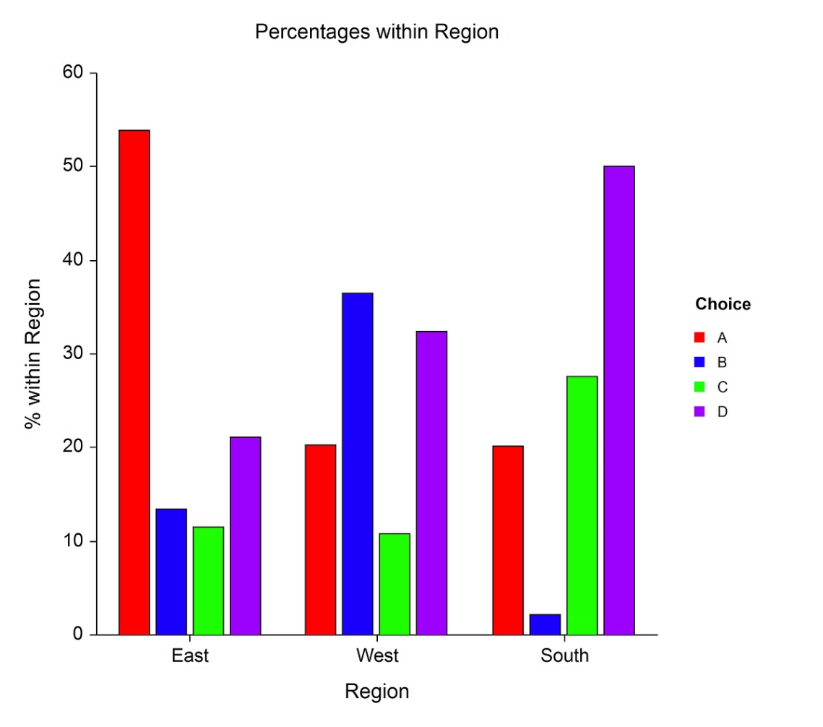
Calculating Basic Statistics
1
Average Salary
2
Median Salary
Calculate the mean salary across all employees to establish a benchmark.
Determine the median salary to understand the central tendency of the data.
3
Standard Deviation
4
Salary Range
Measure the dispersion of salaries to identify the degree of variation.
Calculate the difference between the highest and lowest salaries to understand the overall pay distribution.

Slide 5

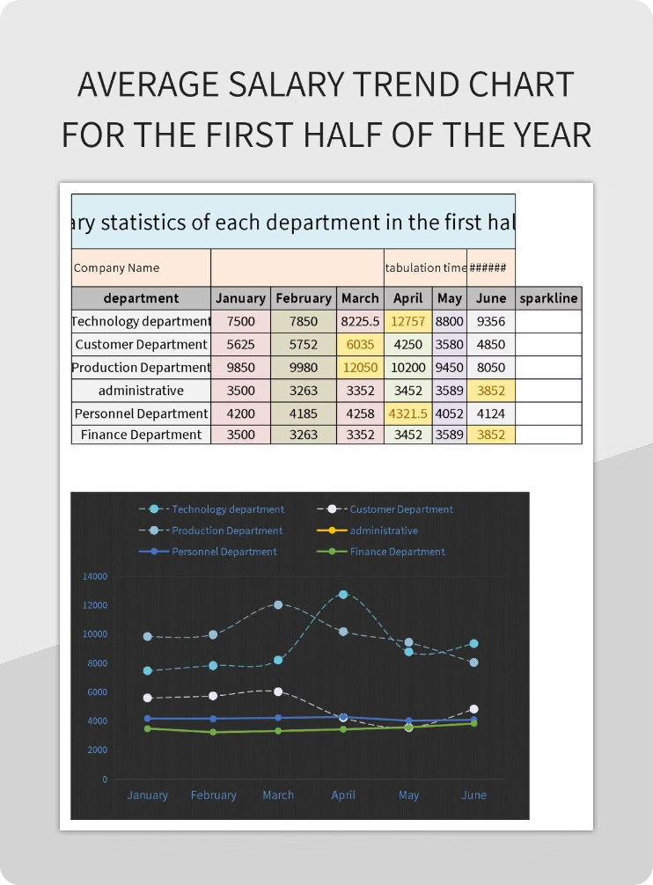



Analyzing Salary Trends
Salary Growth
Examine how salaries have changed over time, both in terms of overall trends and for specific job roles or departments.
Pay Increases
Identify patterns in the frequency and magnitude of salary increases to understand the company's compensation philosophy.
Competitive Landscape
Compare your organization's salary data to industry benchmarks to assess your competitiveness in the job market.

Slide 6

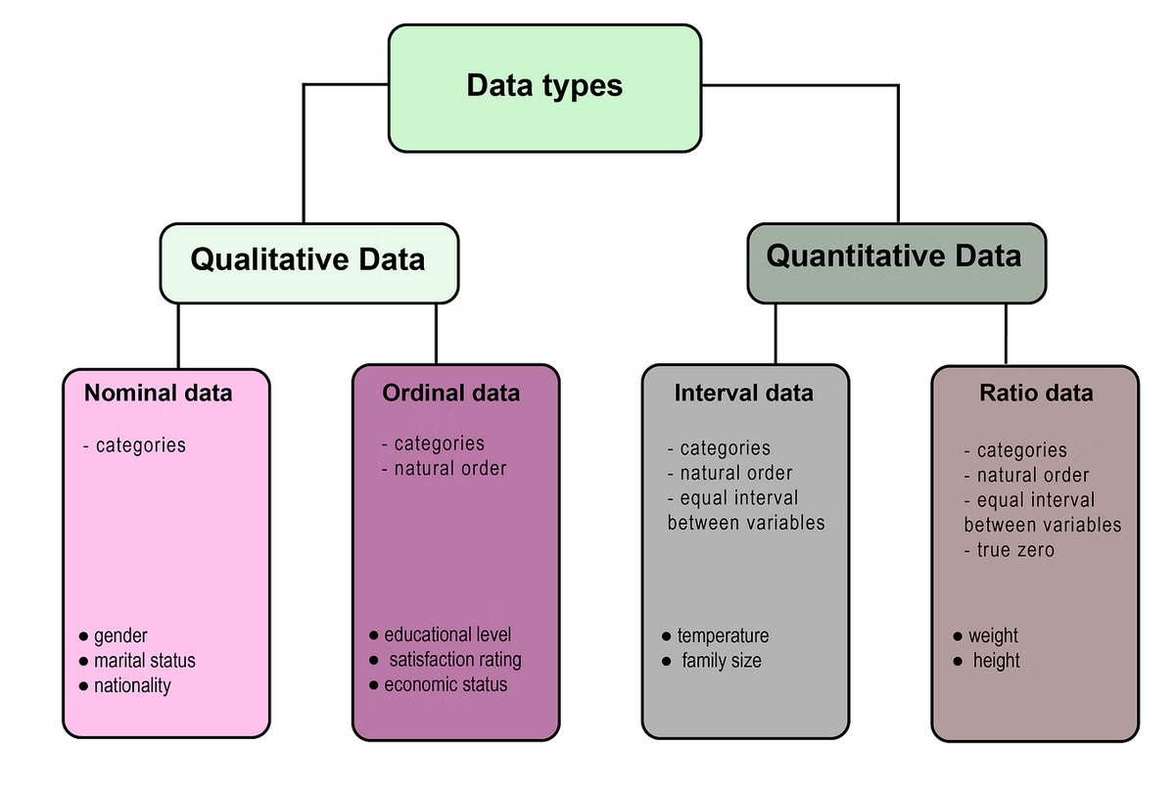
Identifying Outliers and Anomalies
Unusually High Salaries
Unusually Low Salaries
Investigate any employees with salaries that are significantly higher than their peers in similar roles.
Identify any employees with salaries that are substantially lower than their peers, which could indicate potential equity issues.
Salary Compression
Salary Outliers
Analyze the distribution of salaries within job levels to spot any instances of salary compression, where experienced employees are paid similarly to newer hires.
Use statistical techniques to detect any extreme salary values that may require further investigation.

Slide 7



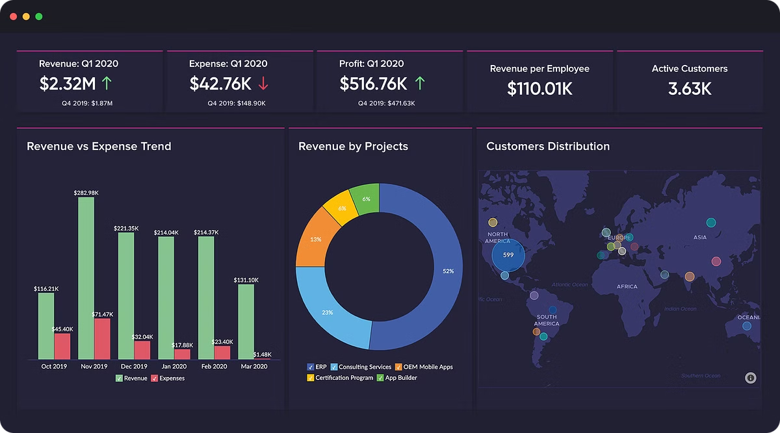


Visualizing Salary Data with Charts
Bar Charts
Line Charts
Visualize salary distributions and trends across different departments or job levels.
Track salary changes over time to identify growth patterns and areas for potential adjustments.
Scatter Plots
Histograms
Analyze the relationship between factors like experience, performance, and salary to uncover potential inequities.
Visualize the distribution of salaries to identify outliers, gaps, and areas of potential compensation imbalance.

Slide 8


Conclusions and Recommendations
1
Key Findings
2
Compensation Strategies
Summarize the main insights and takeaways from your salary analysis, highlighting areas of strength and opportunities for improvement.
Provide recommendations for adjusting your organization's compensation practices to ensure fairness, competitiveness, and alignment with your business goals.
3
Implementation Plan
Outline a clear action plan for implementing the recommended changes, including timelines, stakeholders, and key milestones.

